Slide 1
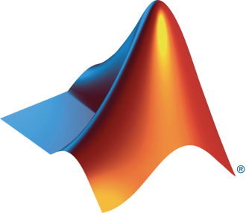

MATLAB Onramp

Slide 2
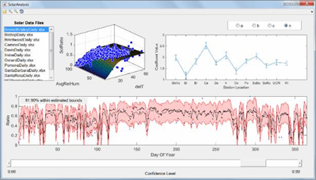
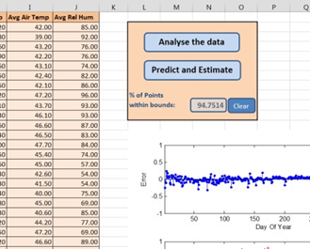

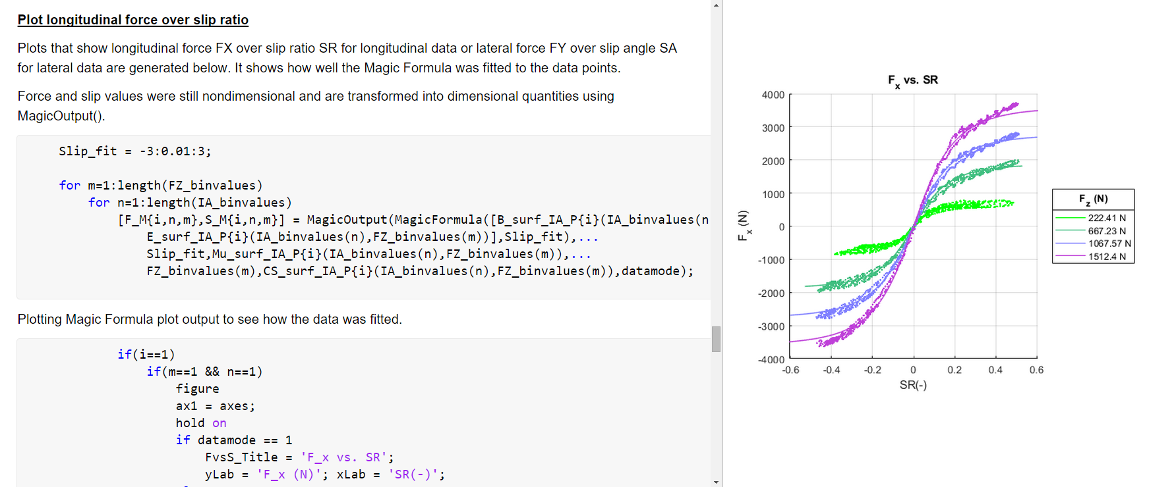
What is MATLAB?
Programming platform designed specifically for engineers and scientists
Matrix-based language
Allowing the most natural expression of computational mathematics
Using MATLAB, you can:
Analyze data
Develop algorithms
Create models and applications

Slide 3


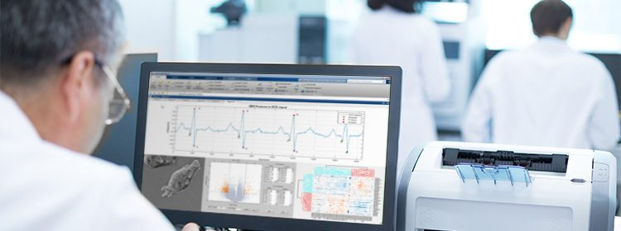

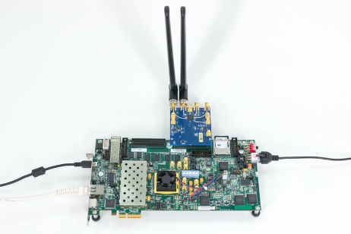


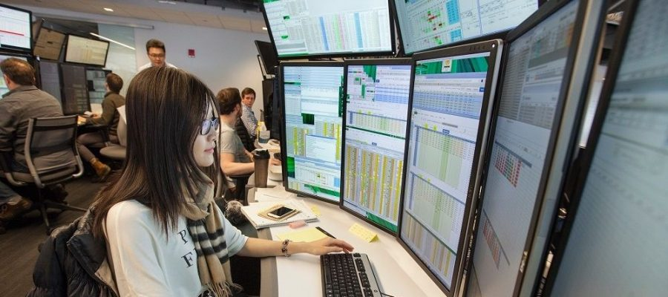

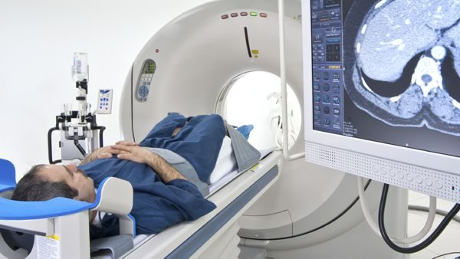

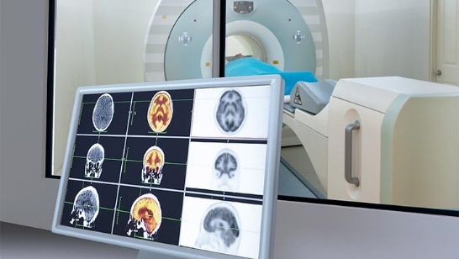


Key Industries that use MATLAB
Aerospace and Defense | Automotive | Biological Sciences | Biotech and Pharmaceutical | Communications
Electronics | Energy Production | Financial Services | Industrial Machinery | Medical Devices
Metals, Materials, Mining | Neuroscience | Railway Systems | Semiconductors | Software and Internet
Notes:
In total, MATLAB is used in over 20 industries, from aerospace and automotive, to biotech, energy production, financial services, medical devices, and railway systems.
What about the companies that use MATLAB? Let’s take a look at some of the key companies that use MATLAB and see if you recognize any.

Slide 4




A few companies that use MATLAB
4 million+
users in 185 countries
Amazon
Apple
AT4 wireless
BAE Systems
Bank of England/PRA
BMW
Boeing
Facebook
Ford Motor Company
Genentech
Google
Huawei
Hydro-Québec
Intel
Johnson & Johnson
JP Morgan
NASA
Nokia
Qualcomm
Samsung
Siemens
Tetra Pak
Texas Instruments
Toyota
“If you want to work at Google, make sure you can use MATLAB”
Jonathan Rosenburg,
former Google Senior Vice President
Business Insider 2014
100,000+
businesses, governments, and universities
All of the top 10 automotive and aerospace companies
OICA: 2017 World Motor Vehicle Production PwC: Aerospace and Defense 2018 Year in Review
Notes:
Millions of engineers and scientists worldwide use MATLAB and Simulink. In fact, there are over 4 million users of our products in 185 countries
Our software is used at over 100,000 businesses, governments, and universities around the world
And all of the top automotive and aerospace companies use our products
Knowing MATLAB is a game changer when looking for a job as former SVP of Google will tell you.
Now that we know what MATLAB is for and where it’s used let’s take a look at how people are using MATLAB to advance the world.

Slide 5
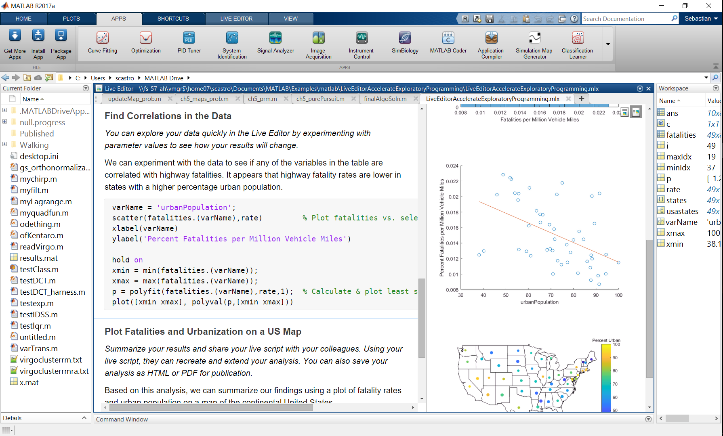
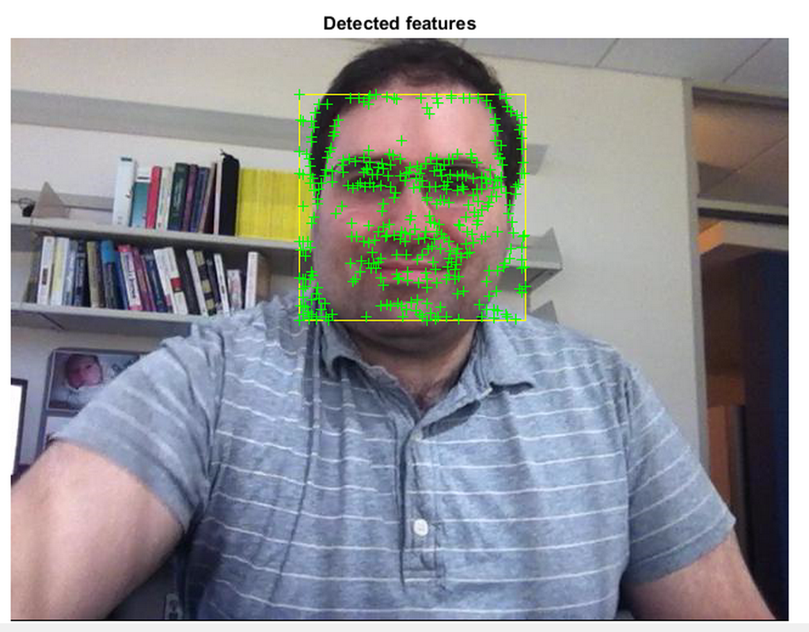
Why Do I Need MATLAB?
Software installations at over 90,000 business, government, and university sites
Enables you to express your ideas and collaborate across disciplines
Model-Based Design is transforming the way engineers and scientists work (Simulink)
Toolboxes and support packages for almost every need

Slide 6
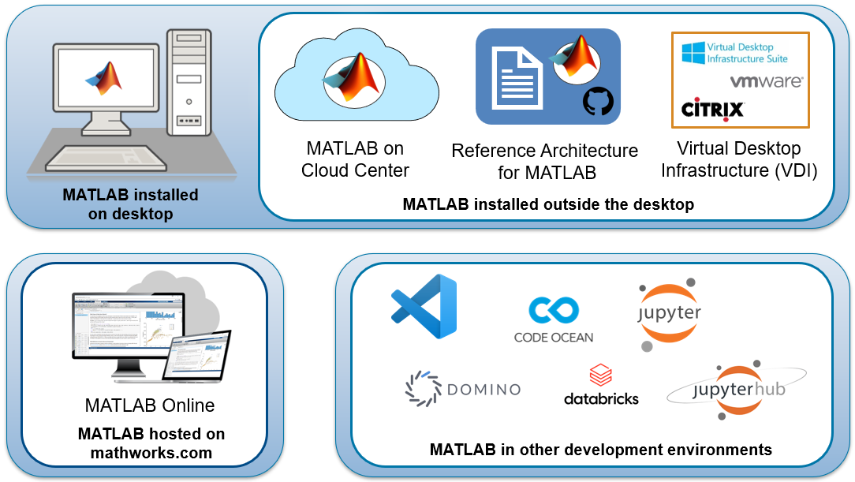
Use MATLAB wherever you are
Notes:
There are many different places and ways you can access and host MATLAB. Of course there’s the traditional approach of a local installation, but you can also use MATLAB in the cloud either through the MathWorks provided Cloud Center or by using our reference architectures to build your own custom cloud setup. MATLAB Online provides a different approach where MathWorks hosts MATLAB for you and you can access it just through your browser. We also know many of you are working in other development environments and we want to meet you where you are, so we’ve added official support for using and running MATLAB within VS Code, Domino, Code Ocean, Databricks, and Jupyter.

Slide 7
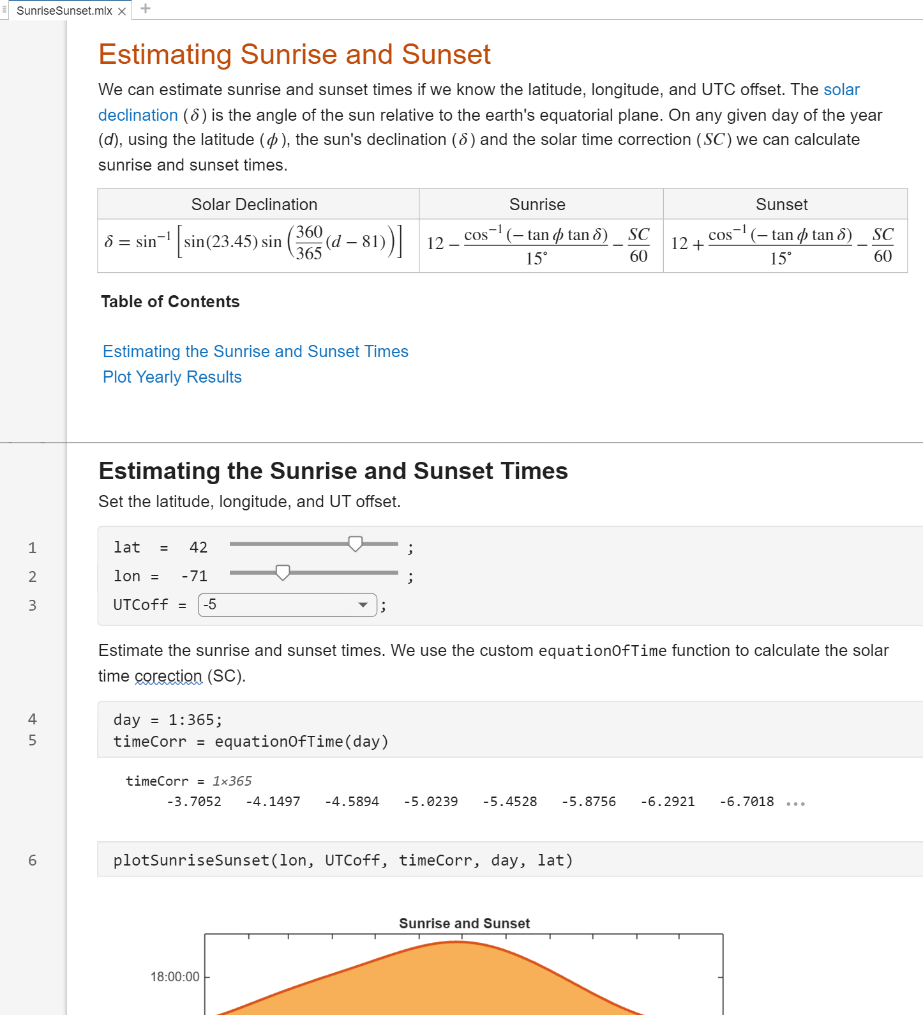
Create interactive, human readable scripts in the Live Editor
Make scripts readable
Richly formatted text
Interleave code & output
Add interactivity
Hyperlinks and table of contents
Live Controls to adjust parameters
Share with non-MATLAB users
Export as report (pdf, docx, etc.)
Share through GitHub and MATLAB Online
Notes:
The Live Editor provides an environment for interactive, human readable scripts.
<click> It provides richly formatted text such as tables and equations, and it interleaves code and output to create an executable document.
<click> You can add interactivity in form of hyperlinks and table of contents, as well as controls such as sliders and drop downs to make modifying the script easier and more intuitive.
<click> You can share these Live Scripts as static reports, or through GitHub and MATLAB Online as we discussed on an earlier slide.

Slide 8
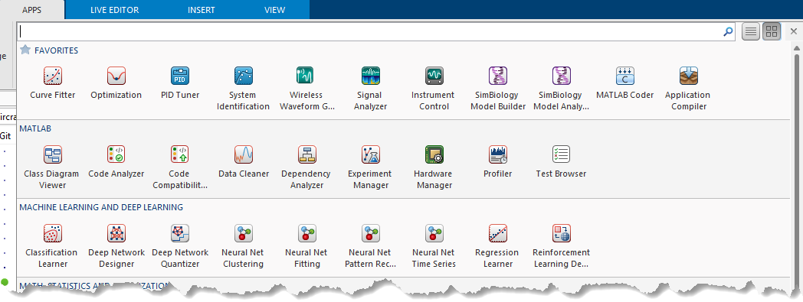
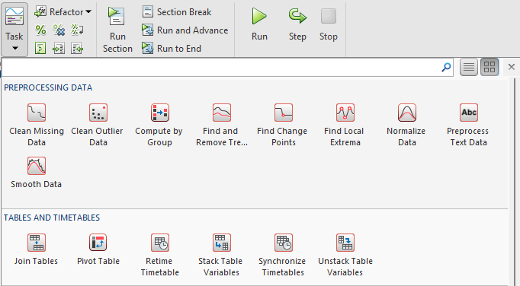
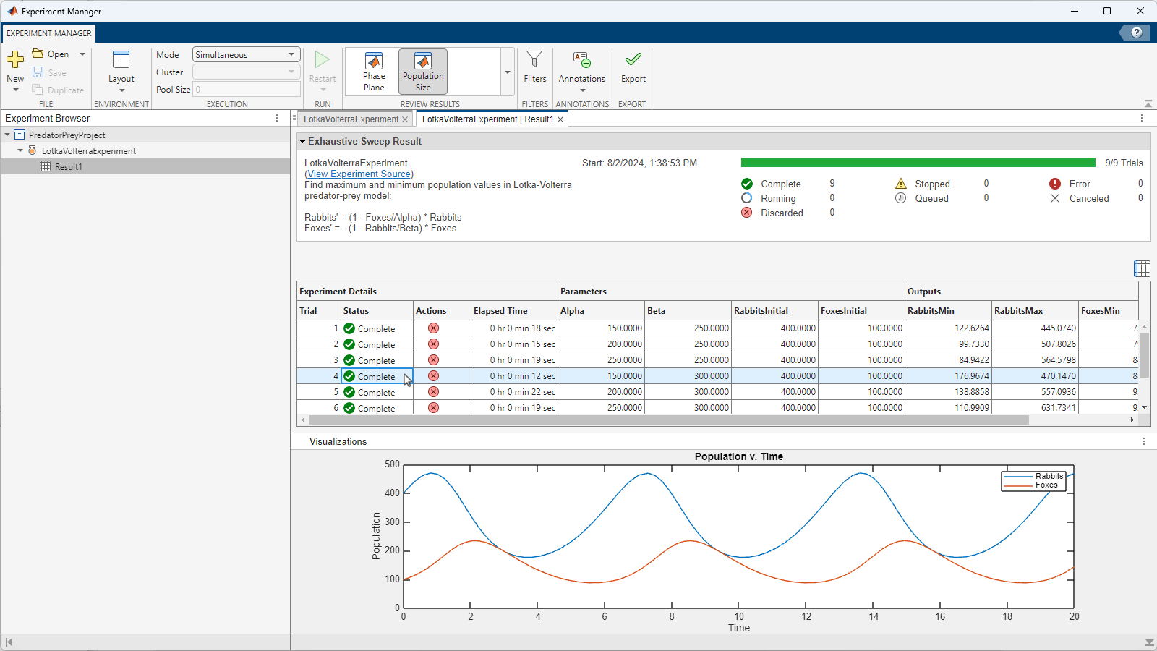
Interactively solve tasks and workflows
Live Tasks solve steps within the Live Editor
Apps solve larger, multi-step workflows
Generate the code for your solution
40+ Live Tasks and 120+ Apps
Build and share custom Tasks and Apps
Notes:
MATLAB provides many tools to interactively and iterative solve both smaller tasks and larger workflows. Live Tasks embed directly in your live script and provide an easy way iteratively solve a narrow problem, such as this example were we can try out different smoothing algorithms to see what works best with our data.
<click> Apps focus on larger workflows, like cleaning data, managing experiments, training machine learning models, and tuning controls systems.
<click> Both tasks and apps generate the MATLAB code to replicate your work whenever that makes sense. We have dozens of these tools across data analysis, engineering, and AI. You can also build and share your own custom tasks and apps.

Slide 9
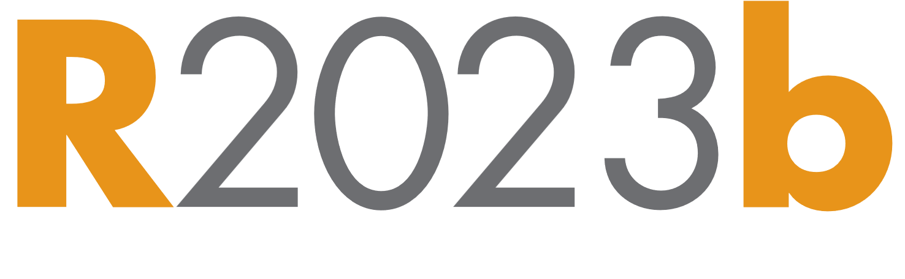
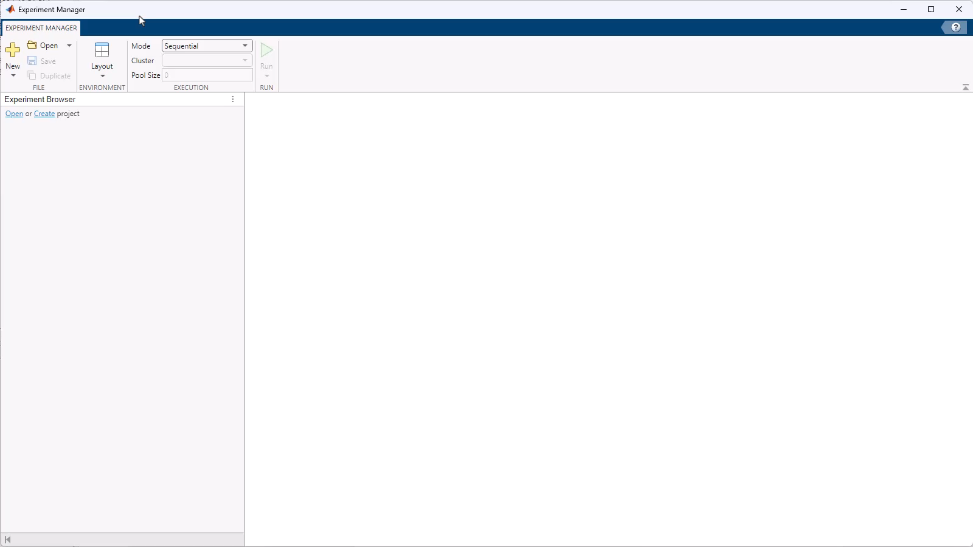
Example: Use Experiment Manager App to perform computational experiments
Create and manage experiments
Parameter sweeps and hyperparameter tuning
Parallel and batch processing
Pre-built experiments for machine learning and AI
Notes:
One example is the Experiment Manager app, which provides tools for setting up and managing computational experiments. The app provides templates for common use cases like parameter sweeps and hyperparameter tuning of machine learning models. We can define the parameters to experiment with, and leverage additional hardware with parallel and batch execution. As we run our experiments, MATLAB keeps track of the results and provides tools for exploring them. This is just one example of over 120 such apps across the platform.

Slide 10










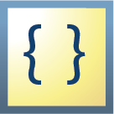





Use data types to express data more naturally
Numeric
datetime
duration
double, single, …
logical
categorical
timetable events
calendarDuration
Heterogeneous
timetable
structure
cell
dictionary
table
Text
{c|h}
char
cell string
string
tall
Notes:
As you’re doing your analysis, you’ll need a way to manage your data. The first kinds of data most MATLAB users encounter is numeric data. This includes basic numbers, as well as logicals, categoricals, and time-based data.
<click> There are also several different heterogenous containers for managing different types of data, including structures, cell arrays, dictionaries, and tables.
<click> Engineering applications often have tabular, timestamped data, such as sensor data recorded over time, which is a great fit for the timetable datatype. This is a special type of table which is indexed by time. Timetable events add onto timetables for managing discrete events within time series data.
<click> There are also several ways of handling text data. The string datatype is the best choice for almost all use cases.
<click> Lastly, tall arrays are special extensions of these datatypes to handle big data. They take the other datatypes, like doubles, strings, and tables, and extend them so they can have more rows of data than can fit into memory. Tall arrays allow you to write normal MATLAB code and are overloaded to automatically handle the computations on these out of memory datasets.

Slide 11
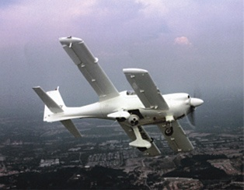
BAE Systems Controls Develops Autopilot for Unmanned Aerial Vehicle
Challenge
Enable teams working in separate locations to design a sophisticated UAV autopilot system quickly and inexpensively
Solution
Use MathWorks tools, modify existing software designs with Model-Based Design, and automatically generate embedded control code
Results
Design and rework costs substantially reduced
Testing cycle time minimized
Coding errors and manual documentation work minimized
An Eagle 150 unmanned aerial vehicle flight.
(Image courtesy of Composites Technology Research Malaysia.)
“MATLAB and Simulink greatly reduced development cycle time and cut system software design and testing costs by 50%.”
- Feng Liang, BAE Systems Controls
Link to user story
Notes:
Industries: Medical devices
Application Areas: Embedded systems, Control systems, Mechatronics, Robotics
Capabilities: Mathematical modeling, Algorithm development, Data analysis, System design and simulation, Rapid prototyping
Products Used: MATLAB, Simulink, Simulink Coder, Simulink Real-Time, Stateflow
Country: The Netherlands
Preceyes Accelerates Development of World’s First Eye-Surgery Robot Using Model-Based Design
Vitreoretinal surgeries, which are performed inside the eye, require a degree of precision and stability that is extremely difficult for the human hand to sustain. A big increase in vitreoretinal diseases, strongly correlated to the aging population, demands the development of new treatments that require even higher levels of precision. A potential new treatment for retinal vein occlusions, for example, would involve inserting a needle into a vein as thin as a human hair and holding it still for about 10 minutes—a task that would be virtually impossible for even the most skilled surgeons.
Surgeons at the John Radcliffe Hospital in Oxford, England, performed the world’s first robot-assisted vitreoretinal surgery in 2016. They used the PRECEYES Surgical System, a robotic assistant that scales the surgeon’s movements and filters hand tremors to enable unprecedented steadiness and precision.
More recently, Preceyes started clinical trials at Rotterdam Eye Hospital. They successfully integrated their newly developed distance sensor in the robot and validated the robot-sensor combination. The sensor measures the distance of an instrument from the retina inside the eye. Providing sensor-based safety and guidance, this approach promises to provide significant safety and performance benefits during demanding retinal surgery. Moreover, it will be a valuable source of data for training and evaluation. Engineers at Preceyes designed and implemented the robot’s control system using Model-Based Design with MATLAB®, Simulink®, and Simulink Real-Time™.
“As a lean startup, it was important for us to achieve a first release quickly without compromising safety, in order to obtain clinical feedback and to build evidence, before designing a final product,” says Maarten Beelen, cofounder and integration manager at Preceyes. “Simulink and Simulink Real-Time enabled us to rapidly design our controller, verify it, implement it on a real-time system, and test it with users. A traditional software development workflow would probably have extended our timeline considerably.”
Challenge
Preceyes set ambitious objectives for its surgical system. Not only would the enhanced precision make new procedures possible, it would also improve existing procedures, such as the peeling of membranes from the retina and the replacement of the eye’s fluid. In working toward these objectives, the Preceyes team had two priorities: to ensure patient safety and to produce a working clinical investigation device as efficiently as possible.
To achieve their design objectives within the development schedule and safety constraints, Preceyes engineers needed to take advantage of modeling and simulation technology that had been used in other safety-critical applications across multiple industries. Specifically, they needed to model complex control logic and then perform functional verification of their design, first via simulation and then via real-time tests on the actual robot. In addition to real-time control software, the team needed to develop a non-real-time application with an interface running on a PC that physicians could use to configure settings before and during surgical procedures.
“MATLAB and Simulink provided a single platform that supported our complete workflow and all the components and protocols we needed for our robotic system. That enabled us to quickly develop a safe, real-time device, ready for clinical investigation.”
- Maarten Beelen, Preceyes
Solution
Preceyes used Model-Based Design with MATLAB, Simulink, and Simulink Real-Time to accelerate the development of a real-time control system for its PRECEYES Surgical System.
While constructing a basic model of the robot’s kinematics and dynamics, Preceyes engineers conducted system identification tests in which they used Simulink Real-Time to produce excitation signals for the robot’s 11 electromotors and then measured the responses across each of its 11 degrees of freedom.
After analyzing and fitting the measurement data in MATLAB, they used the results to develop a Simulink plant model that described how the robot moved in response to applied forces.
The team developed a controller model that processes input from the system’s joystick and approximately 60 sensors—including optical and magnetic encoders—and generates the necessary motor signals to move the tool tip in response to the surgeon’s movements. Within this model, they incorporated EtherCAT blocks from Simulink Real-Time to interface with nodes on the robot’s EtherCAT network.
Using Stateflow®, the team modeled sequential logic for the system’s various operating modes, which include calibration, initialization, and self-verification.
After verifying the basic operation of the controller and control logic through simulation, the engineers generated code from their model using Simulink Coder™ and deployed the compiled code to a real-time target computer running Simulink Real-Time. This computer was connected to the robot’s sensors and motors via the EtherCAT network.
To refine and enhance the controller, the team made improvements to the model, checked them via simulation, and then tested them on the actual robot using the Simulink Real-Time setup.
The engineers used GUIDE, a MATLAB UI development tool, to develop the touch-screen application software that surgeons use to change surgical settings and receive visual and acoustic feedback during surgery.
The safety and efficacy of the PRECEYES Surgical System has been demonstrated in 14 surgical procedures. Additional demonstrations are planned at top surgical sites, including a two-year collaboration with Rotterdam Eye Hospital. The company is also working on CE registration and the next generation for volume production.
Results
■ Core controller developed by one engineer. “With MATLAB and Simulink, I did not have to program a low-level architecture for the controller by myself. As the sole software engineer developing the first release, that was a huge advantage—in fact, I doubt if a single engineer could have done the work otherwise,” says Beelen. “The software was extensively reviewed by consultants, which was quite easy because of the readability, requirement traceability, and report generation capabilities in Simulink products.”
■ Patient safety assured. “I always said I would not bring a device to market unless I was fully confident using it on myself or on a loved one,” notes Beelen. “With the safety mechanisms we had implemented in Simulink, I was 100% comfortable that there would be no problems with the software.”
■ Road map to industrialization set. “For the development of the industrialized release of our system, we will save time by generating code from our existing controller model, using Embedded Coder to target an embedded processor,” says Beelen. “We will follow a more formal development and testing workflow, with improved revision control and a larger development team, using model-based testing, verification, and validation capabilities in Simulink.”
Learn more about Preceyes: www.preceyes.nl

Slide 12
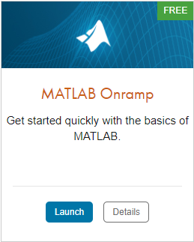
TO DO
Go to https://matlabacademy.mathworks.com/
Log in to your MathWorks account
Launch MATLAB Onramp

Slide 13
Additional Learning Resources:
Follow @matlab_students on Instagram for tips/tricks, videos, and more!
This account is managed by MathWorks and is specifically for students!
Star the Awesome MATLAB Student Repository on GitHub and Bookmark the MATLAB & Simulink Resources for Students page.
Check out some of the other Student Program opportunities at MathWorks.

